Slide 1

Performance Evaluation of a Virtualized HTTP Proxy in KVM and Docker
rodrigo eiras, rodrigo couto, Marcelo rubinstein

Slide 2
Agenda
Introduction on NFV
NFV as Standard and Lightweight Virtualization
Performance Evaluation
Conclusion
Future Work

Slide 3


Introduction on NFV

Slide 4
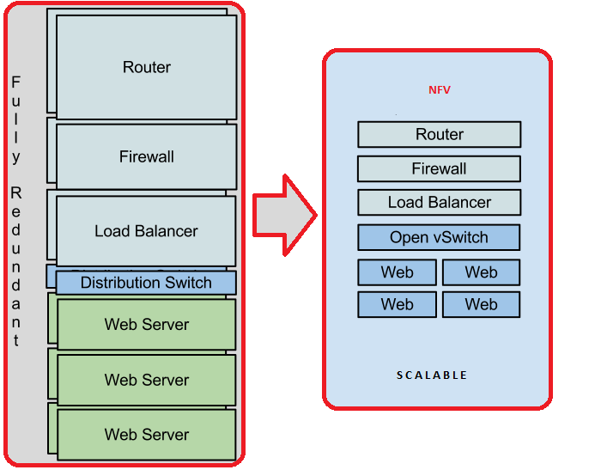
Introduction on NFV
Network Function Virtualization (NFV) is a recent paradigm
Many Network Functions (NFs), such as ﬁrewalls, load balancers, proxies and NATs can be implemented as VNFs

Slide 5
Introduction on NFV
The challenge of NFV is to provide similar performance when compared to dedicated hardware solutions
Notes:
In virtualized environments, applications may have a lower performance compared to native solutions (i.e., applications without virtualization).

Slide 6
Motivation & Objective
Our goal is identify if the container solution can be a good alternative to deploy HTTP Proxy service as VNF
In addition, we evaluate the proxy service working as cache service and packet forwarder using the NFV approach

Slide 7
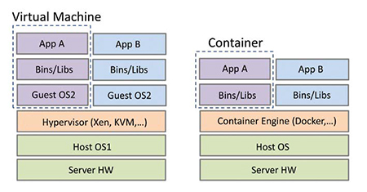
NFV as Standard and Lightweight Virtualization
As NFV employs the virtualization concept, VNFs can run on top of virtualization solutions originally developed for datacenters
Notes:
Standard virtualization solutions employ a software layer called hypervisor, that lies between the hardware and the virtual machines (VMs).
The main issues regarding the adoption of hypervisor-based approaches, such as KVM, is the performance bottleneck that it imposes in VMs.

Slide 8

NFV as Standard and Lightweight Virtualization
The main issues regarding the adoption of hypervisor-based approaches, such as KVM, is the performance bottleneck that they impose in VMs

Slide 9

NFV as Standard and Lightweight Virtualization
Lightweight virtualization, also called container-based virtualization, provides a different level of abstraction in terms of virtualization and isolation, when compared with hypervisors

Slide 10
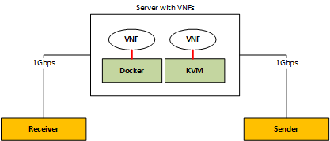
Performance Evaluation

Slide 11
Performance Evaluation
Squid 3 Proxy as VNF
Apache 2 HTTP Server
Apache 2 Benchmarking Tool

Slide 12
Performance Evaluation
We evaluate the performance of KVM and Docker using proxy as a VNF. We also evaluate a proxy in a native Linux as a baseline
Our tests focus on measuring the total time needed to receive responses for 10,000 requests

Slide 13
Performance Evaluation
We insert in every test 12 fork processes on the physical server in which the proxy is executed
STRESS

Slide 14
Performance Evaluation
Each experiment is repeated 10 times and 95-conﬁdence intervals were plotted
STRESS

Slide 15
1st Case: Processing time [s] comparison with No Concurrency and No Cache System

Slide 16
1st Case: Processing time [s] comparison with No Concurrency and No Cache System

Slide 17
1st Case: Processing time comparison with No Concurrency and No Cache System

Slide 18
2nd Case: Processing time [s] comparison with 100 Concurrent Connections and No Cache System

Slide 19
2nd Case: Processing time [s] comparison with 100 Concurrent Connections and No Cache System

Slide 20
2nd Case: Processing time comparison with 100 Concurrent Connections and No Cache System

Slide 21
3rd Case: Processing time [s] comparison with No Concurrency and Cache Enabled

Slide 22
3rd Case: Processing time [s] comparison with No Concurrency and Cache Enabled
STORED

Slide 23
3rd Case: Processing time [s] comparison with No Concurrency and Cache Enabled

Slide 24
3rd Case: Processing time [s] comparison with No Concurrency and Cache Enabled

Slide 25
3rd Case: Processing time comparison with No Concurrency and Cache Enabled

Slide 26
Conclusion
We provided a performance analysis of an NFV application using Squid 3 proxy for two different types of state-of-the-art virtualization technologies
It is possible to conclude that Docker can be a good alternative to work as HTTP proxy in a NFV environment

Slide 27
Future Work
We will analyze Docker scalability
We will perform the experiments using more than one instance for each VNF to naturally stress the physical computer and evaluate the performance in an environment closer to a production network

Slide 28
Thank you!
rsveiras@gmail.com
rodrigo.couto@uerj.br
rubi@uerj.br

